Slide 1
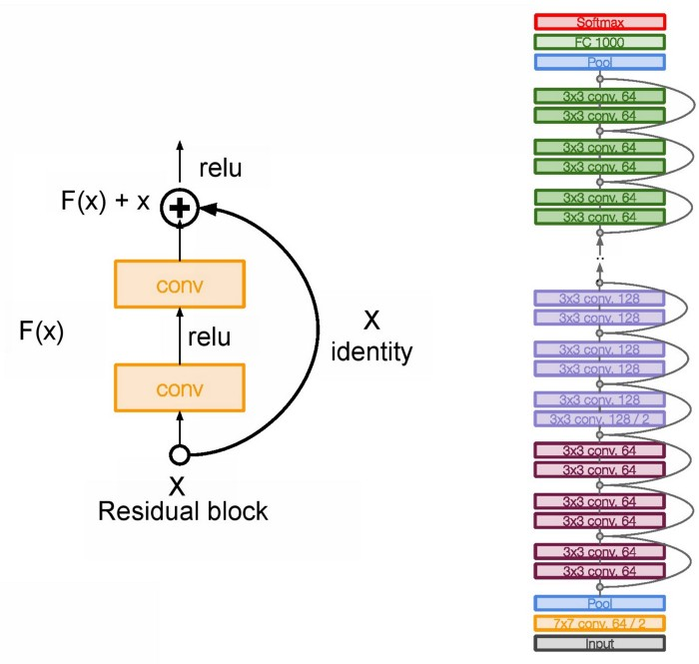
ResNet

Slide 2
The main base element of ResNet is the residual block.
As we go deeper into the network with a large number of layers, computation becomes more complex.
These layers put on top of each other and every layer try to learn some underlying mapping of the desired function and instead of having these blocks, we try and fit a residual mapping.

Slide 3
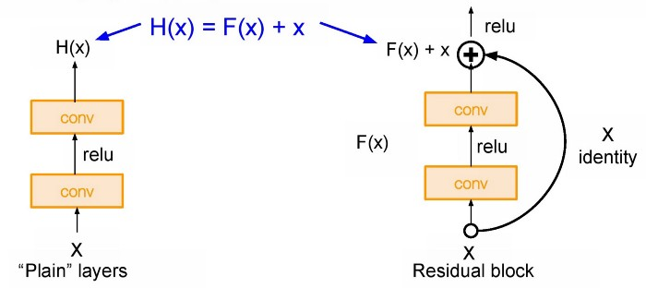
as we go deeper into the network it is so hard to learn H(X) as we have a large number of layers.
So here we used skip connection and learning F(x) direct input of x as the final output. So F(x) is called as a Residual.

Slide 4
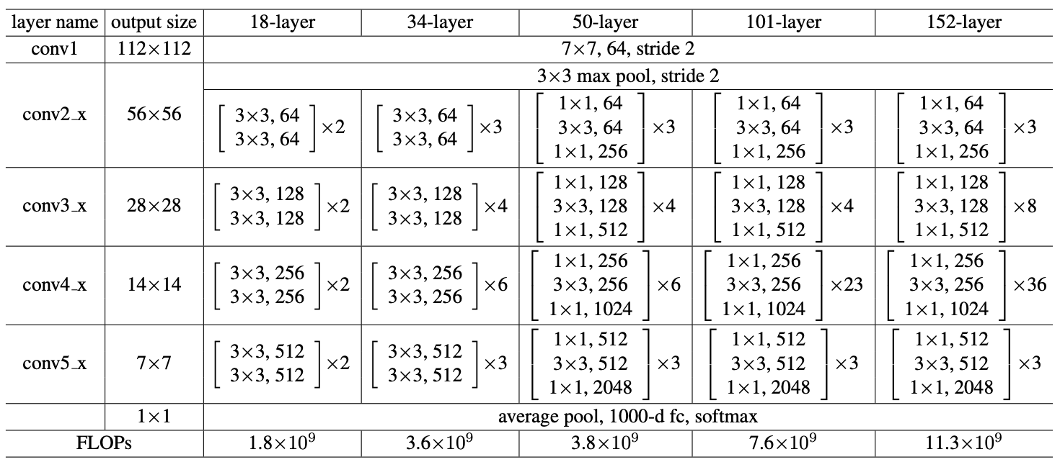

Slide 5
In ResNet, stacks all these blocks together very deeply.
Another thing with this very deep architecture is that it is enabling up to 150 layers deep of this, and then what we do is we stack all these layers periodically.
We also double the number of filters and downsample spatially using stride two.
In the end, only fully connected layer 1000 to output classes

Slide 6
Hyperparameters
In ResNet, it uses Batch Normalization after every conv layer.
It also uses SGD + Momentum.
The learning rate is 0.1 and is divided by 10 as validation error becomes constant.
Moreover, batch-size is 256 and weight decay is 1e-5. T
he important part is there is no dropout is used in ResNet.

Slide 7
Increasing the depth (number of layers) is not the only way to make a model bigger.
What about increasing both the depth and width of the network while keeping computations to a constant level?
The main purpose is dimension reduction, by reducing the output channels of each convolution block. Then we can process the input with different kernel sizes.
This in turn allows to not only increase the depth, but also the width of the famous GoogleNet by using Inception modules. The core building block, called the inception module, looks like this:

Slide 8
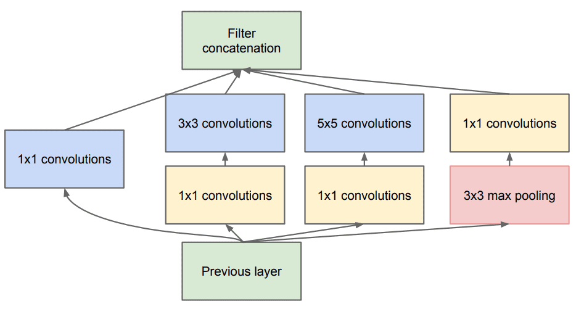
InceptionNet

Slide 9
In general, a larger kernel is preferred for information that resides globally, and a smaller kernel is preferred for information that is distributed locally.
The InceptionNet/GoogLeNet architecture consists of 9 inception modules stacked together, with max-pooling layers between (to halve the spatial dimensions). It consists of 22 layers (27 with the pooling layers). It uses global average pooling after the last inception module.

Slide 10
